Slide 1
SUCCESS OF A NEW PARTNER

Slide 2
Everyone needs the Unfranchise
How do you succeed?
The Unfranchise® Business
Commitment to Building the 2-3 Year Plan
Spending 8-15 Hours of Dedicated Time Per Week
Take Action

Slide 3
The best product was and is
Belief

Slide 4
Help your partners develop…
Burning DESIRE
Winning ATTITUDE
Unwavering COMMITMENT
Pinpoint FOCUS
True GRIT

Slide 5
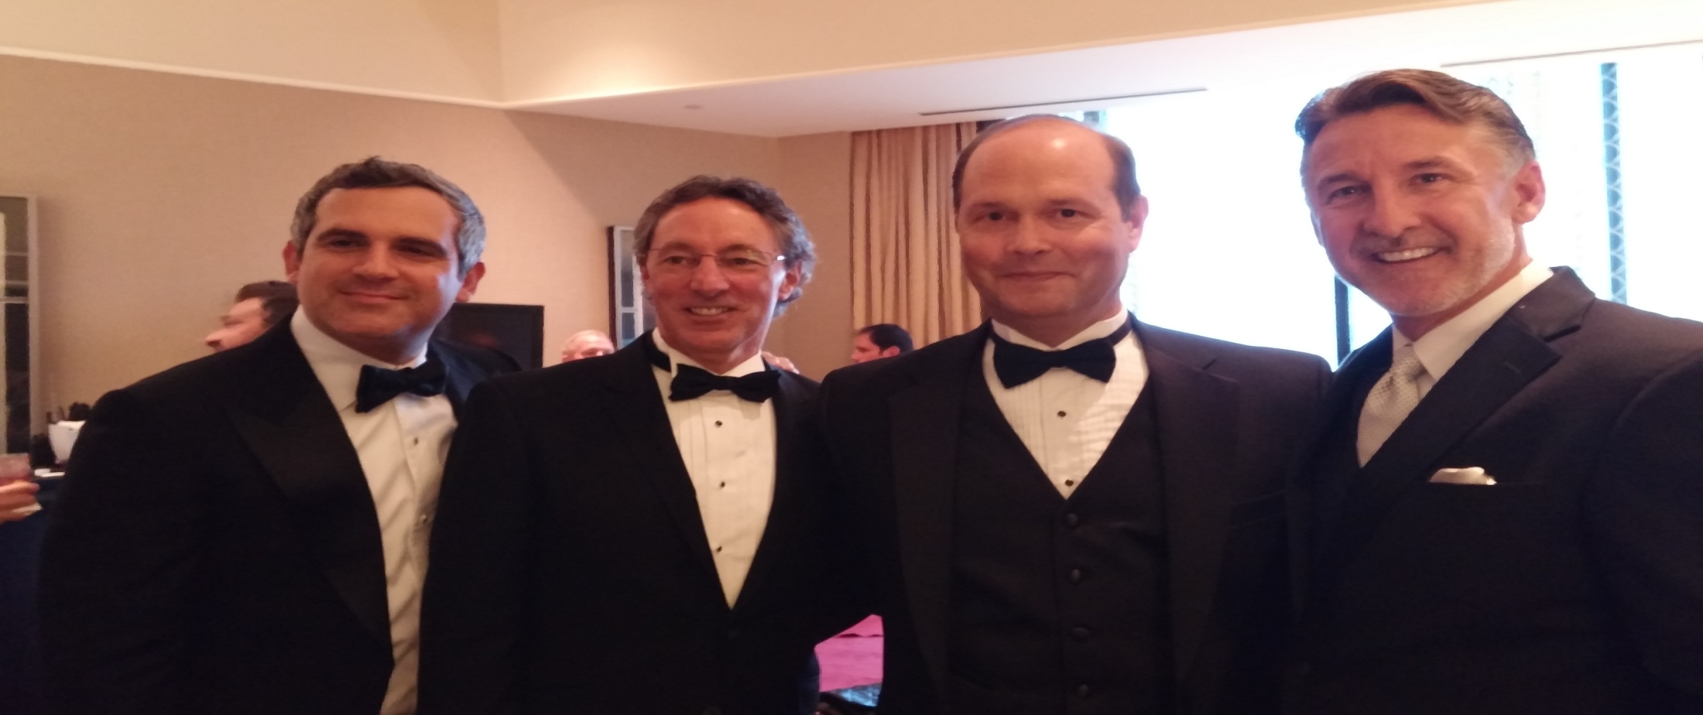
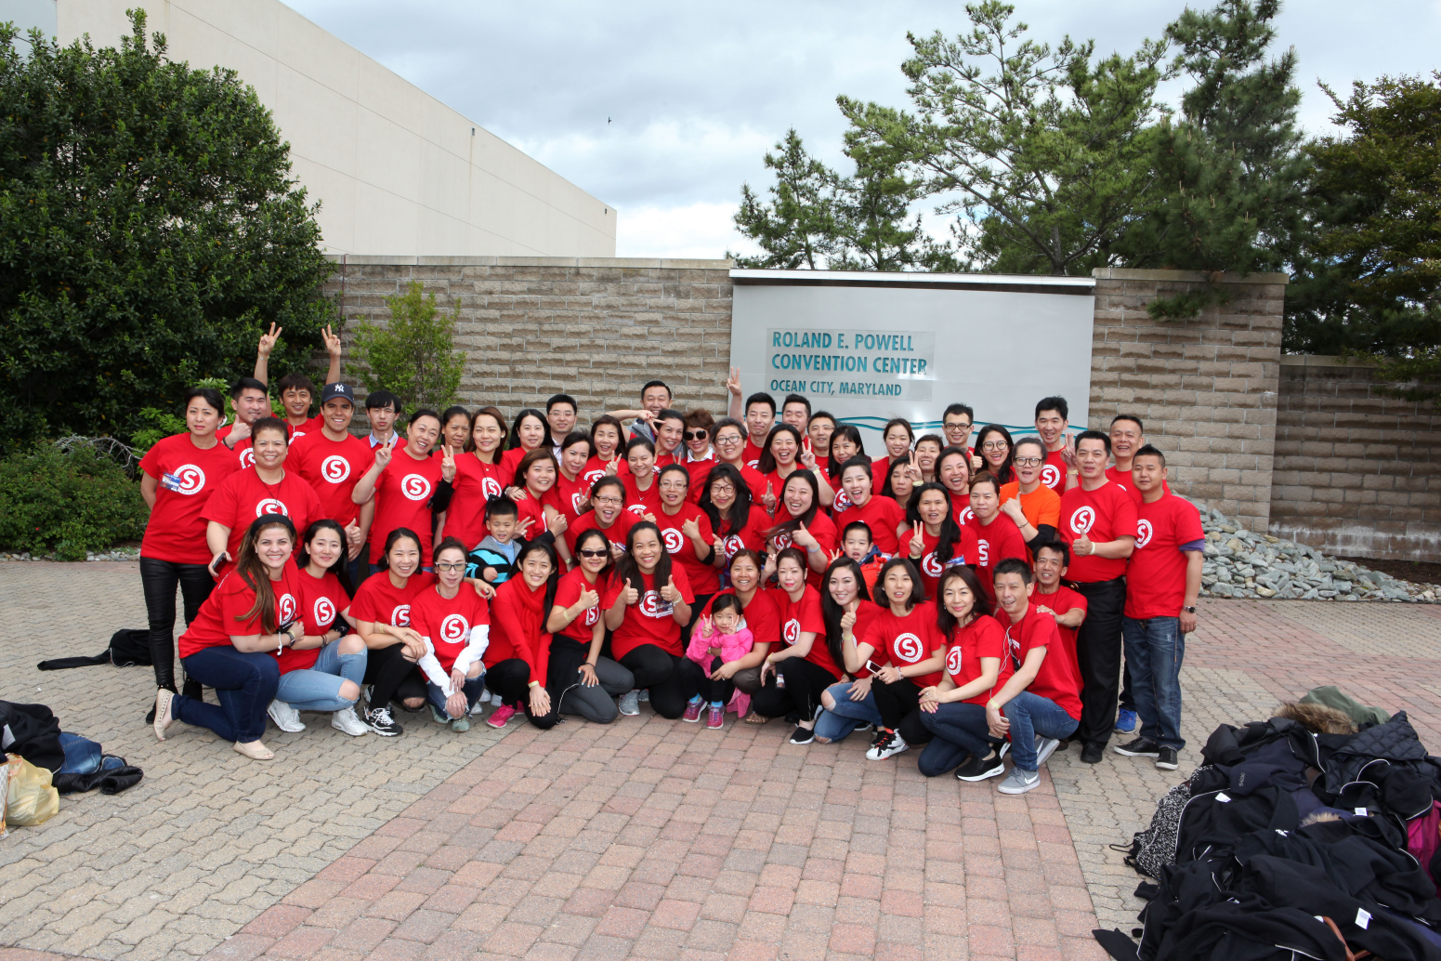
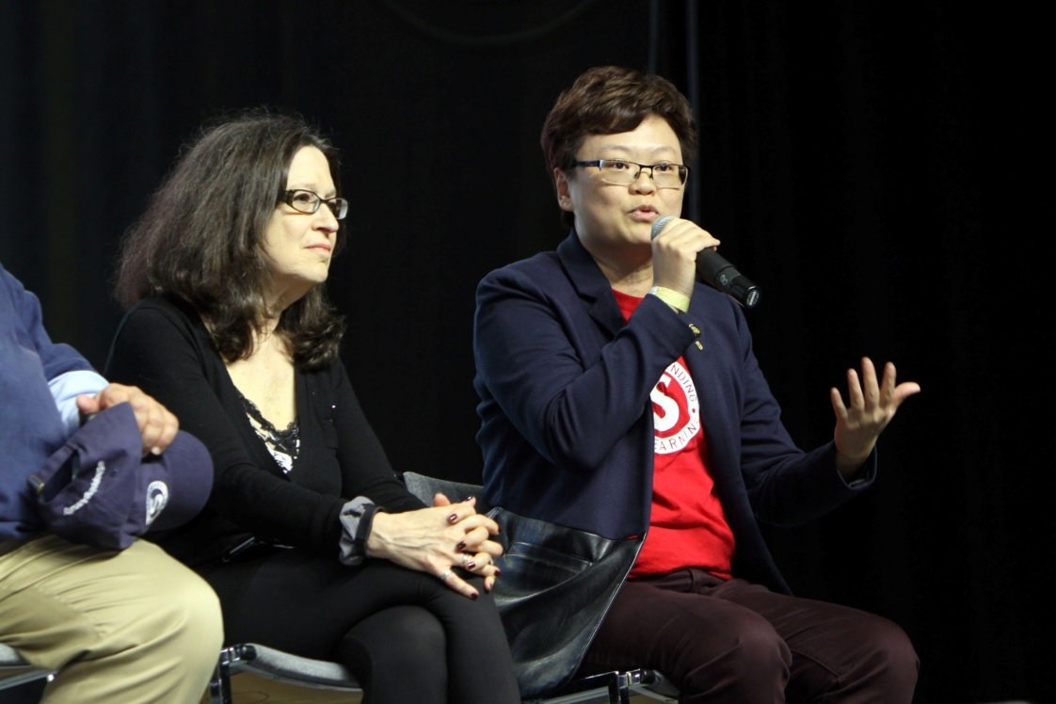
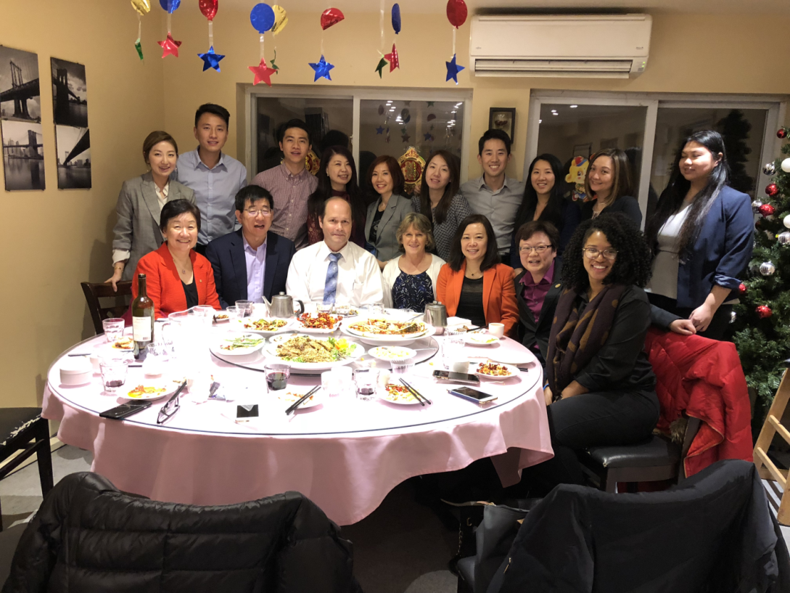
Surround yourself with partners that have the same mission!

Slide 6
RESIDUAL INCOME Only Meaningful With Longevity!

Slide 7
People will being WILLING to follow you, not because of the position you hold, but because of the person you are.
It’s all about RELATIONSHIPS!

Slide 8
KEYS TO SUCCESS
They must be enthusiastic, coachable and follow the system for 30 to 90 days. They don’t know what to do, you coach them, lead.
2 to 3 years
Set a date for a meeting in their location, home office, or to see a friend. Understand why this is the KEY! Get them to lead to the people + make it work first! If they lead to people it worked. If they don’t commit– you still have the people they led too.
Use the Getting Started Guide and make a list. Want to guarantee results? Have a call workshop or call the people with them.

Slide 9
FIRST
THREE MONTHS
Product of the Product
Take your Shopping Annuity Assessment
Have a Goal and Plan of Action
Select 2-3 Products or Service to Build Base 10 - (University Major, the Pace, two new customers or 50 new BV a week)
Sponsor Two Qualified Business Partners
Learn the Getting Started Guide

Slide 10
First Quarter
---C
---C
---C
C-
C-
C-
C-
C-
-C
-C
-C
-C
-C
GO NOW
PS
PS
10 – 15 Customers

Slide 11
SECOND
THREE MONTHS
Personally Sponsor 2 New Unfranchise Owners (UFOs)
Build out Base 10, Seven Strong
Earn $300 in commission a month, starting by Month Six
Master the Getting Started Guide
Showing the Plan 2 on 1 and then to 1 on 1
Bringing Guests to the UBPs
Be Accountable to the Agreed Upon Plan of Action
Become a Shopping Annuity Master Member
Taking Responsibility for Success
Showing the Plan Once per Week (More is Better)
Initiating Mentoring to Team

Slide 12
Second Quarter
---C
---C
---C
C-
C-
C-
C-
C-
GO NOW
-C
-C
-C
-C
-C
PS
PS
---C
---C
---C
C-
C-
C-
C-
C-
-C
-C
-C
-C
-C
C-
C-
C-
C-
C-
-C
-C
-C
-C
-C
PS
PS

Slide 13
THIRD
THREE MONTHS
Bringing Guests to the UBPs
Be Accountable to the Agreed Upon Plan of Action
Requalify as a Shopping Annuity Master Member
Taking Responsibility for Success
Showing the Plan Once per Week
Continue to Mentoring the Team
Personally Sponsor 2 New Unfranchise Owners (total of six)
Earning $600 in commission a month starting Month 9
Teaching the Getting Started Guide
Understands the Logic of the Plan (You can draw out the plan on paper)
Becoming a Good Follower
Using the Tools
Implementing The Getting Started Guide with New UFOs
Optimistic, Competitive, Driven (highly motivated)

Slide 14
Third Quarter
GO NOW
PS
PS
PS
PS
PS
PS

Slide 15
FOURTH
THREE MONTHS
Personally Sponsor 2 New Unfranchise Owners – (total 8)
Earn $1500 in Commission Per Month – (December, CEC)
Become a Master Unfranchise Owner – Months 10-12
Conducting Basic 5 and NUOT
Participate in Local and National Challenges
Becoming Independent of Sponsor
Aligned with Market Australia’s Mission
Believe – Duplication is happening on your team and you are on your way to achieving your financial goals

Slide 16
Fourth Quarter
GO NOW
PS
PS
PS
PS
PS
PS
$1500 Per Month
At The End of 1 Year
PS
PS

Slide 17
Your Ideal Organization
Accrued GIBV Totals
YOU
Accrued GIBV Totals
5000 IBV
IBV
BV
BV
IBV
5000 IBV
3600 IBV
IBV
BV
BV
IBV
3600 IBV
2400 IBV
IBV
BV
BV
IBV
2400 IBV
1200 IBV
IBV
BV
BV
IBV
1200 IBV
H & N
Motives
Motives
Skin Care
Transitions
H & N
H & N
OPC-3
DNA
Internet Shopping
OPC-3
Motives
OPC-3
Personal Care
HP
Internet Shopping
Skin Care
OPC-3
H & N
Motives
HP
Recruiter
HP
Personal Care
Anti-Aging
Web
Transitions
Web
Recruiter
DNA
Anti-Aging
Web
Notes:
17
Talking Points
Have already developed Distributors with customers, now have customers use Web Portals
Provide Endless Shopping Experience™ through Web Portals
Build strong relationships with customers on a one-to-one basis
Sustain dialogue and obtain feedback with and from Preferred Customers to identify what they want and need
Sell existing customers more products/services (within the product line, within the store, within the Mall, within the Partner Stores)
Increase profitability and security
Selling more products to fewer people is more efficient and more profitable than the time honored mass-marketing rules of pitching products to the greatest number of people

Slide 18
YOU HAVE TO CARE
You have to connect with your team
You have to hold a vision
You have to have faith

Slide 19
Bottom Line…
It begins with you!
You have the tools
Pick up the phone and call or text people
Make a physical names list
Learn to show the plan
Attend training
Attend the UBP
Build from house to house to house
AND HAVE A TON OF FUN DOING IT!

Slide 20
Successful Unfranchise Owners live a few years of their lives like most people won’t so they can spend the rest of their life like most people can’t!

Slide 21
T&C’s apply

Slide 23
SUCCESS OF A NEW PARTNER

